Slide 1
Presented By
Hello Doctor Complete Online Medical Support
Abdullah Al Nayim CSE 063 07519
Sanzida Islam Suchi CSE 063 07514
Md. Nur-E-Alam Shikdar CSE 063 07431

Slide 2
Information Gathering & Interview
Objectives
Construct meaningful interview questions
Understanding the client & organization’s view
Understanding the current system
Requirement & features Analysis
Creating Use case diagram
Creating data flow diagram

Slide 3
Questionnaires & Interview Pattern
For information gathering we have chosen three methods.
Interview
Questionnaires
Investigations

Slide 4
Interview Structure
Interview structure was Funnel type.
5 open ended question in beginning.
7 close ended question after that.

Slide 5

Interviewee
Mr. Al Amin Shaheen
Marketting Officer, Ibn Sina Hospital
15/A, Dhanmondi, Dhaka

Slide 6
Interview Questions
Question 01: How ISH usually take appoinment for doctors?
Answer: Patient have to take their appoinment physically or by a phone call at Ibn Sina Hospital.Patient ask for their desired doctors at preferable time.If available,we give them confirmation through phone call.
Question 02: Do you think this an old process of communication ?
Answer: Yes I think this an old process of communication in this modern age of global village.
Question 03: How ISH promote their doctors ?
Answer: Ibn Sina Hospital promote their doctors by postering or through some banner in front of hospital.

Slide 7
Interview Question
Question o4: Do you think it’s a good marketting policy to reach most possible clients ?
Answer: I don’t think it’s a good marketting policy to reach most possible clients .
Question 05:Do you have any future plan about promotion and appoinment system?
Answer: We have some plan to make promotion through internet and social media. And make the appoinment system more easy to clients.

Slide 8
Interview Question
Question 06: How much phone calls you need to attand for doctors appoinment everyday ?
Answer: Approximately 500-700.
Question 07: Don’t you think that it’s a big bothering ?
Answer: Yes! I think it’s a matter of bothering.
Question 08: Do you have any website ?
Answer: Yes.We have a website .
Question 09:Do you have any web based appoinment system for clients ?
Answer: No

Slide 9
Interview Question
Question 10: Do you think that ISH need a web based appoinment system to reduce clients suffering ?
Answer: Yes! I believe it
Question 11: Do you think you need to update doctors list by website ?
Answer: Yes.
Question 12 : Do you believe that a web based appoinment system will reduce ISH sufferings for getting clients ?
Ans: Yes.

Slide 10
Survey Questions
Number of Questions : 09
Question Type: Specific

Slide 11
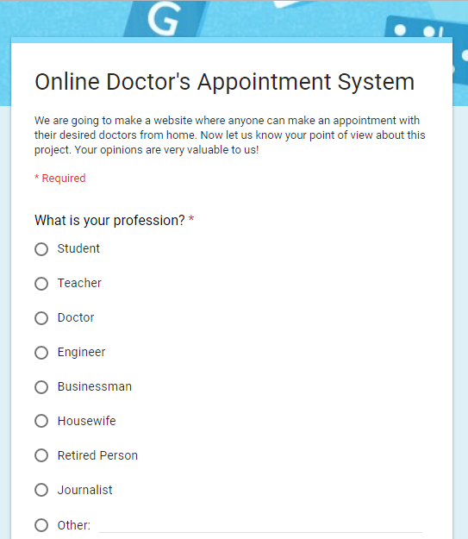
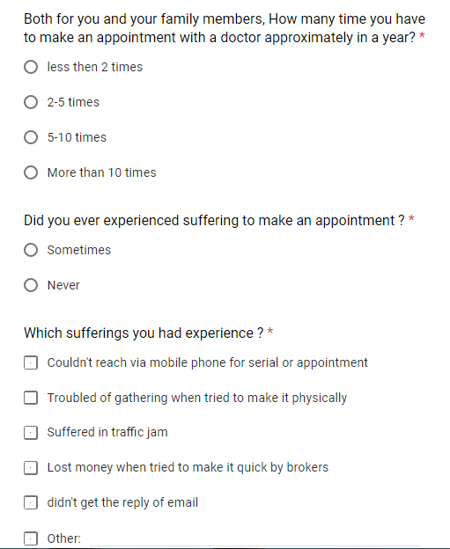
Survey Questions

Slide 12
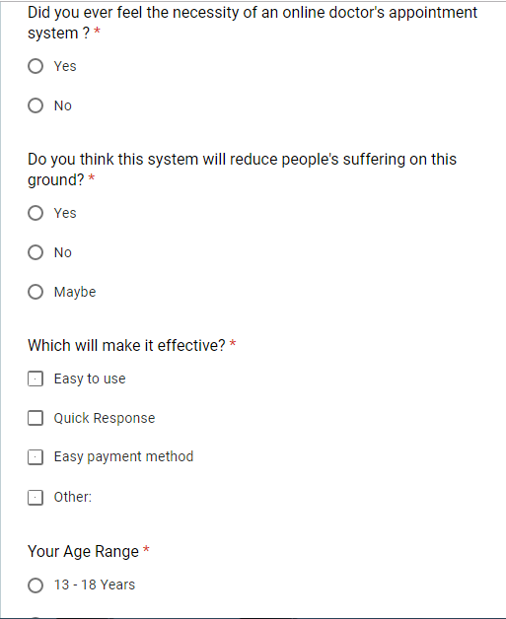
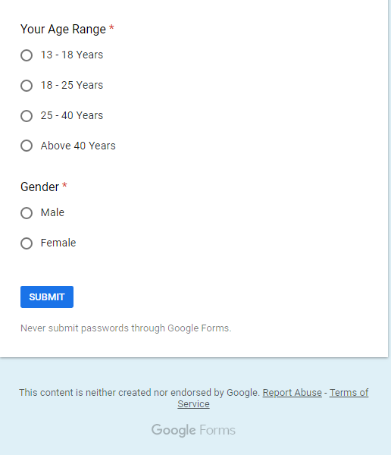
Survey Questions

Slide 13
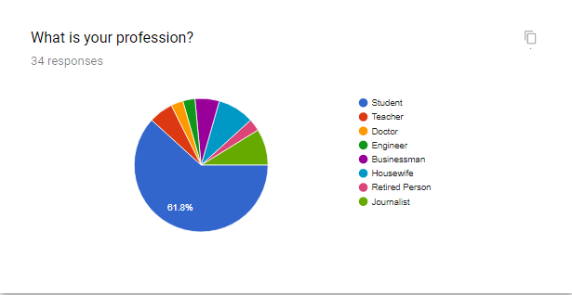
Survey Results
13

Slide 14
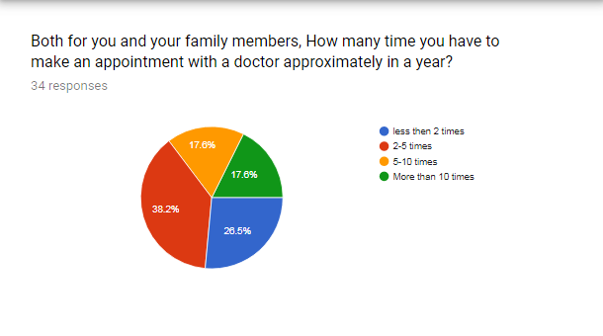
Survey Results (Continued)

Slide 15
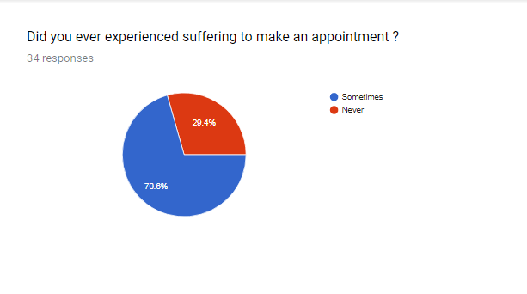
Survey Results (Continued)
Survey Results (Continued)

Slide 16
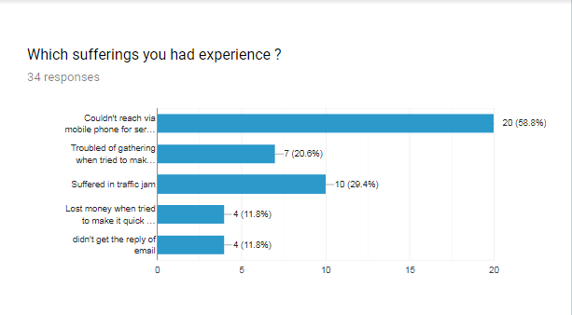
Survey Results (Continued)

Slide 17
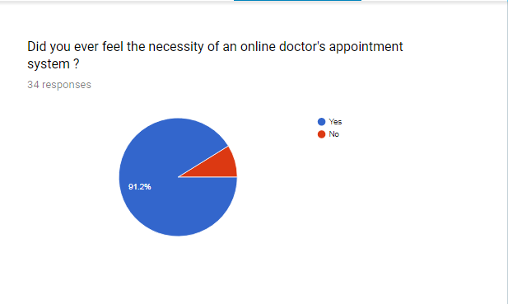
Survey Results (Continued)

Slide 18
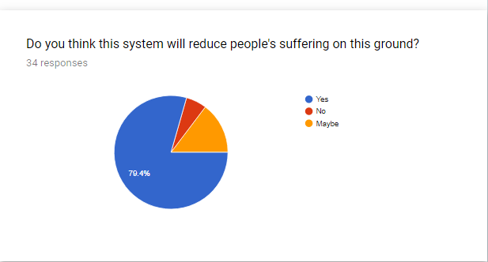
Survey Results (Continued)

Slide 19
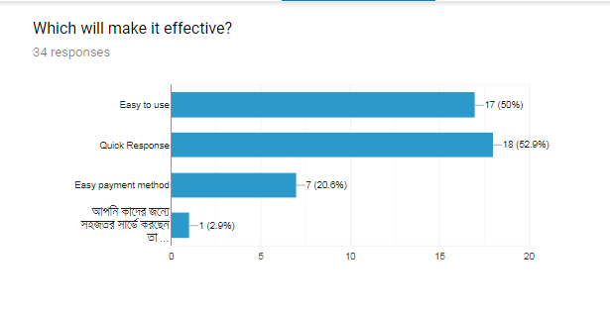
Survey Results (Continued)

Slide 20
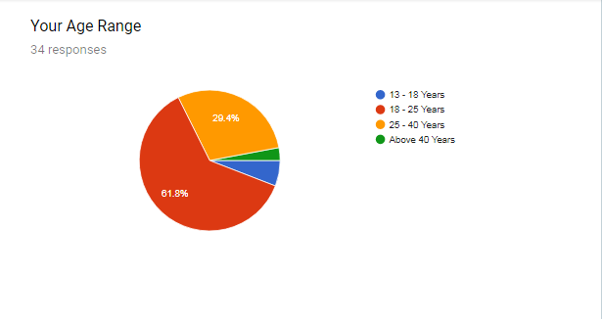
Survey Results (Continued)

Slide 21
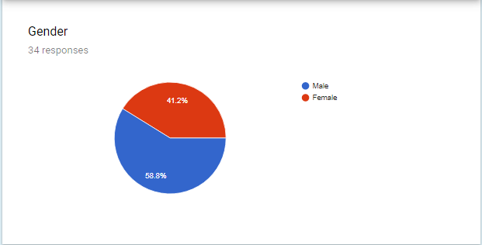
Survey Results (Continued)

Slide 22
Investigations
Almost 80% hospital do not have an active system of doctors appointment
More than 48% people suffered when tried to make an appointment by phone
More than 88% people suffered when tried to make an appointment physically at the hospital .
Less than 5% hospitals have a web based doctor’s appointment system .

Slide 23


